Slide 1

Segmentation
Raghu Prasad Konandur
9845547471
www.kaushalya.tech
raghuprasadkonandur@kaushalya.tech

Slide 2
Object classification and segmentation
Object classification and segmentation — both are part of machine learning based image processing to train the AI algorithms through computer vision. And both are important for object recognition precisely in machine learning and AI development.
Segmentation in an image is the process of the breaking down the digital image into multiple segments (that is divided into the set of different pixels into an image). The purpose of segmentation is to simplify or change the representation of an image into an easier format making to more meaning for machines to analyze.

Slide 3
Semantic segmentation
Semantic segmentation is useful in detecting and classifying the object in an image when there is more than one class in the image. Hence, there are two popular techniques are used — Semantic segmentation and instance based Segmentation is used for objects nested classification create objects having separate regions.
The difference between segmentation and classification is clear at some extend. And there is a one difference between both of them. The classification process is easier than segmentation, in classification all objects in a single image is grouped or categorized into a single class. While in segmentation each object of a single class in an image is highlighted with different shades to make them recognizable to computer vision.

Slide 4
Semantic segmentation
Image semantic segmentation is also widely used for medical imaging analysis in healthcare sector. It is used in diagnosing the various types of diseases for deep learning to find out the accurate illness through computer vision and predict the possible outcomes helping doctors to take faster decision for right treatment.

Slide 5
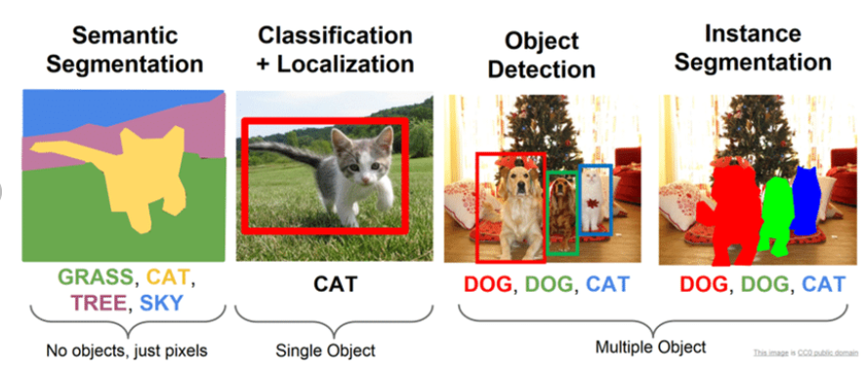
Segmentation

Slide 6
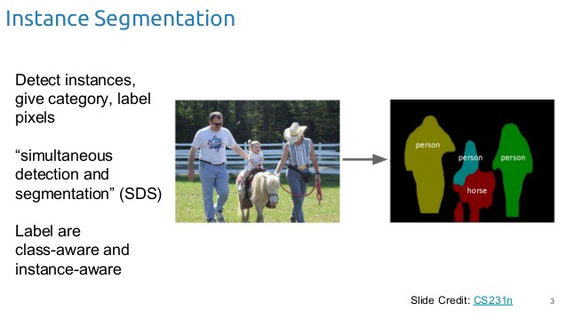
Instance Segmentation

Slide 7
Instance Segmentation
Instance segmentation is one step ahead of semantic segmentation wherein along with pixel level classification, we expect the computer to classify each instance of a class separately. For example in the image above there are 3 people, technically 3 instances of the class “Person”. All the 3 are classified separately (in a different color). But semantic segmentation does not differentiate between the instances of a particular class.

Slide 8
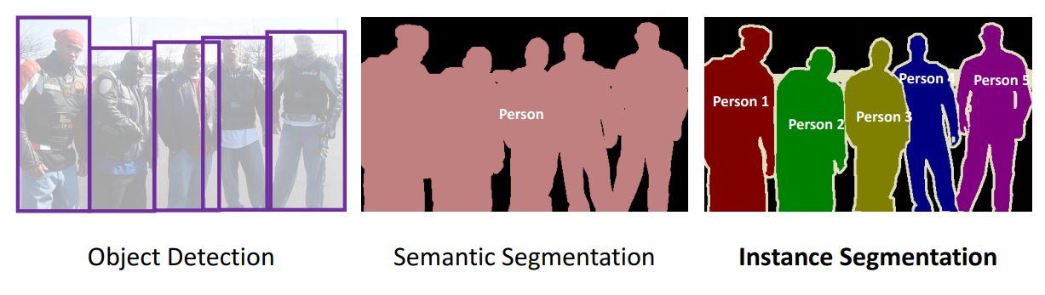
Object detection,Semantic Segmentation,Instance Segmentation

Slide 9
UNet
After applying convolutional neural networks (CNN) heavily to classification problems now it’s time to explore more about the potential of CNN. Apart from classification, CNN is used today for more advanced problems like image segmentation, object detection, etc.
Image segmentation is a process in computer vision where the image is segmented into different segments representing each different class in the image.
Segmentation helps to identify where objects of different classes are present in an image.
UNet is a convolutional neural network architecture that expanded with few changes in the CNN architecture. It was invented to deal with biomedical images where the target is not only to classify whether there is an infection or not but also to identify the area of infection.

Slide 10
UNet
After applying convolutional neural networks (CNN) heavily to classification problems now it’s time to explore more about the potential of CNN. Apart from classification, CNN is used today for more advanced problems like image segmentation, object detection, etc.
Image segmentation is a process in computer vision where the image is segmented into different segments representing each different class in the image.
Segmentation helps to identify where objects of different classes are present in an image.
UNet is a convolutional neural network architecture that expanded with few changes in the CNN architecture. It was invented to deal with biomedical images where the target is not only to classify whether there is an infection or not but also to identify the area of infection.

Slide 11
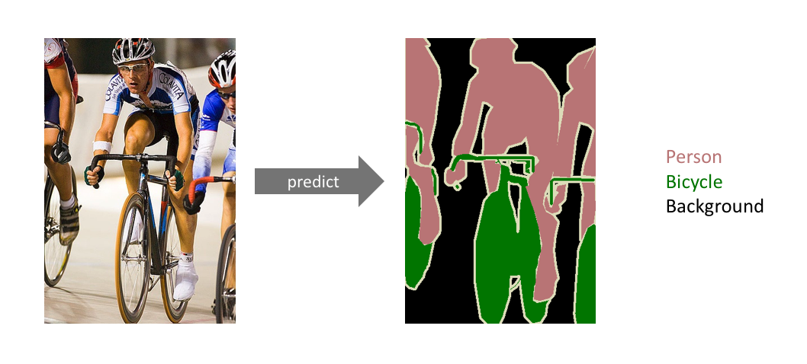
UNet-Semantic Segmentation

Slide 12
UNet-Semantic Segmentation
The goal of semantic image segmentation is to label each pixel of an image with a corresponding class of what is being represented. Because we’re predicting for every pixel in the image, this task is commonly referred to as dense prediction
Note that unlike the previous tasks, the expected output in semantic segmentation are not just labels and bounding box parameters. The output itself is a high resolution image (typically of the same size as input image) in which each pixel is classified to a particular class. Thus it is a pixel level image classification.

Slide 13
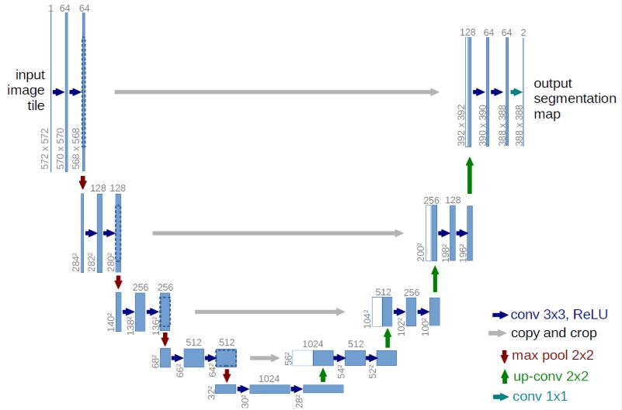
UNet-Architecture

Slide 14
UNet-Architecture
The UNet architecture was introduced for BioMedical Image segmentation by Olag Ronneberger et al. The introduced architecture had two main parts that were encoder and decoder.
The encoder is all about the covenant layers followed by pooling operation. It is used to extract the factors in the image.
The second part decoder uses transposed convolution to permit localization.
It is a Fully Convolutional Network (FCN). You can read the original published paper U-Net: Convolutional Networks for Biomedical Image Segmentation. Also, read more about UNet architecture that is published with the name as Understanding Semantic Segmentation with UNet.

Slide 15
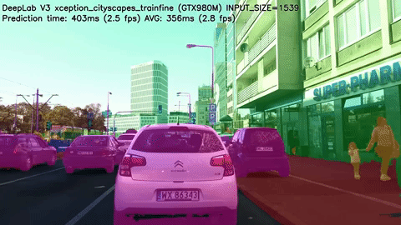
Applications – Autonomous Vehicles
Autonomous driving is a complex robotics tasks that requires perception, planning and execution within constantly evolving environments. This task also needs to be performed with utmost precision, since safety is of paramount importance. Semantic Segmentation provides information about free space on the roads, as well as to detect lane markings and traffic signs.
Source: https://www.youtube.com/watch?v=ATlcEDSPWXY

Slide 16
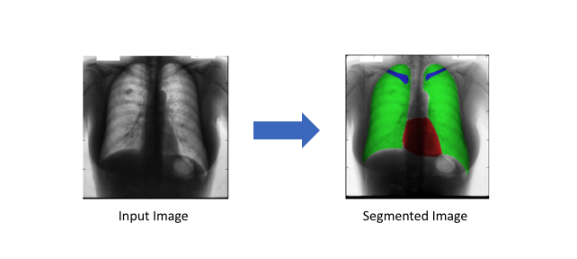
Applications – Bio Medical Image Diagnosis
Machines can augment analysis performed by radiologists, greatly reducing the time required to run diagnostic tests.

Slide 17
Applications – Geo sensing
Semantic Segmentation problems can also be considered classification problems, where each pixel is classified as one from a range of object classes. Thus, there is a use case for land usage mapping for satellite imagery. Land cover information is important for various applications, such as monitoring areas of deforestation and urbanization.
To recognize the type of land cover (e.g., areas of urban, agriculture, water, etc.) for each pixel on a satellite image, land cover classification can be regarded as a multi-class semantic segmentation task. Road and building detection is also an important research topic for traffic management, city planning, and road monitoring.
There are few large-scale publicly available datasets (Eg : SpaceNet), and data labeling is always a bottleneck for segmentation tasks.

Slide 18
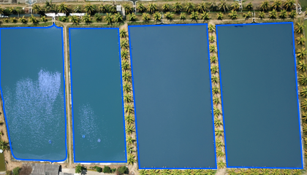
Applications – Geo sensing
Source: https://blog.playment.io/semantic-segmentation/

Slide 19
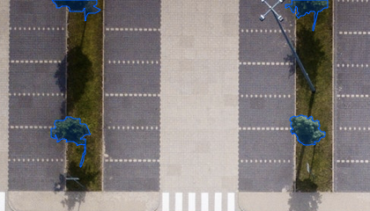
Applications – Precision Agriculture
Precision farming robots can reduce the amount of herbicides that need to be sprayed out in the fields and semantic segmentation of crops and weeds assist them in real time to trigger weeding actions. Such advanced image vision techniques for agriculture can reduce manual monitoring of agriculture.

Slide 20
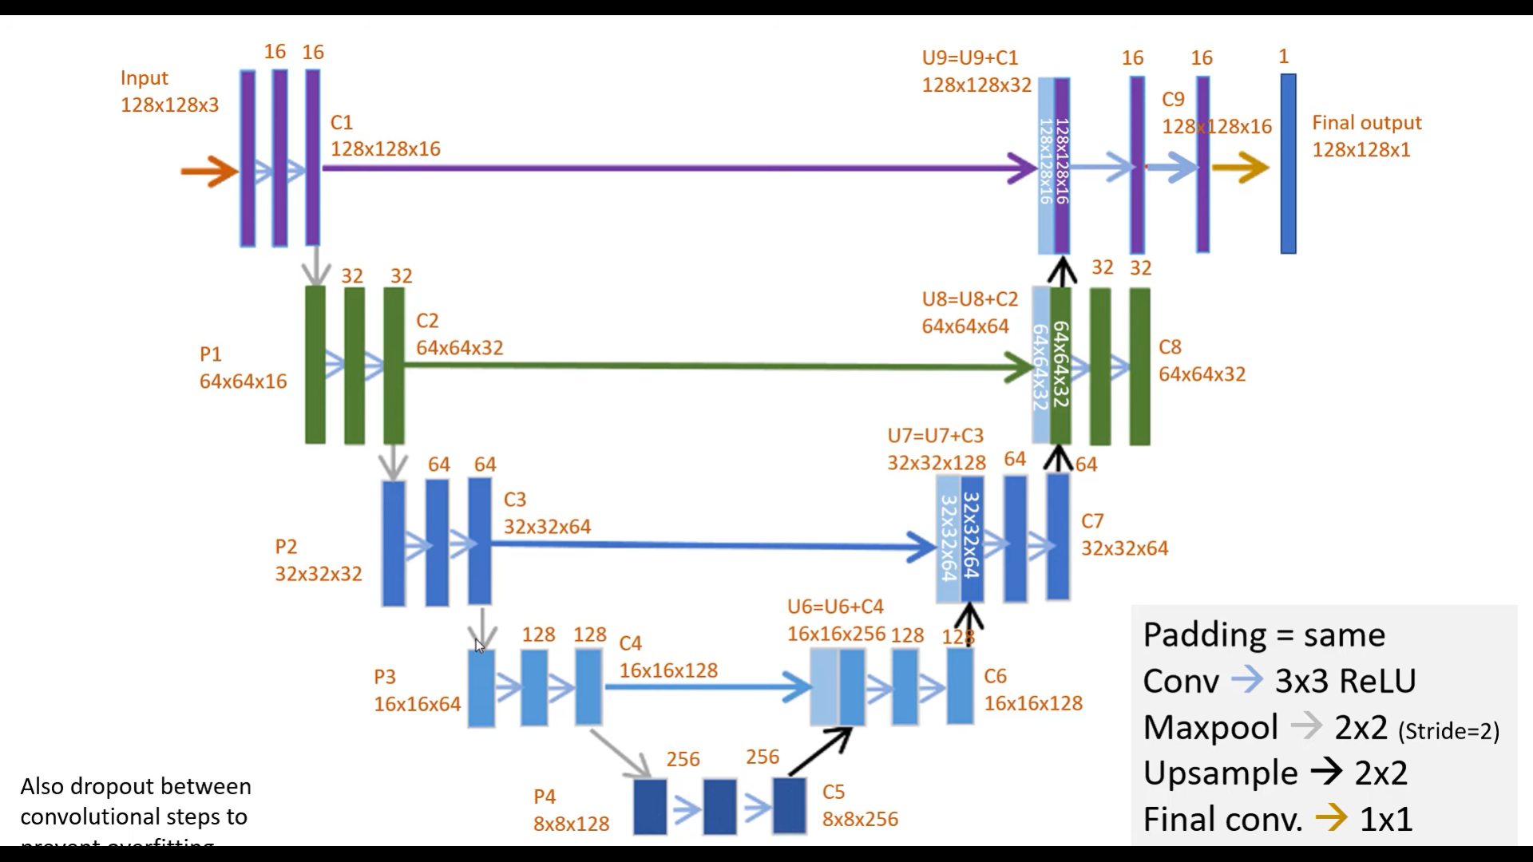
Building a sample UNet Model

Slide 21
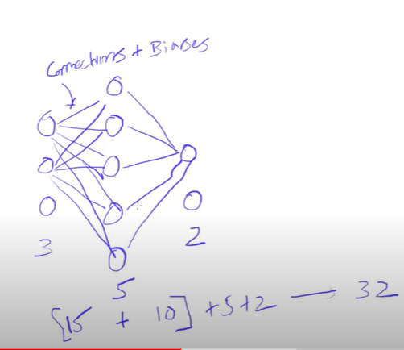
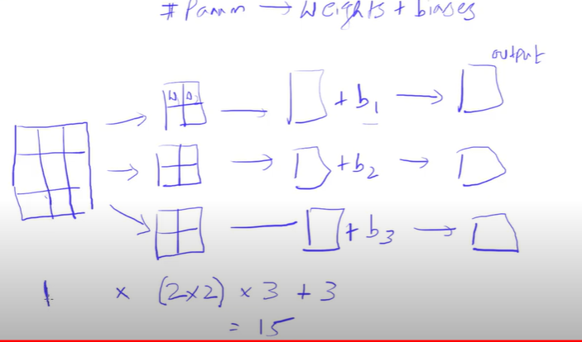
Building a sample UNet Model-Parameter calculation

Slide 22
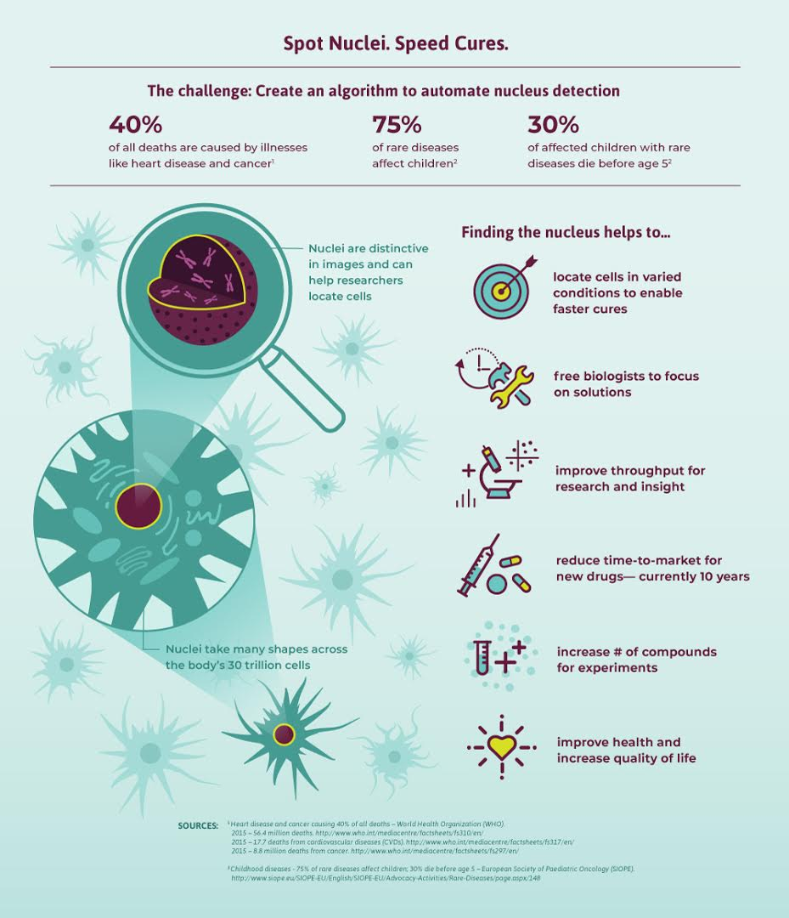
Case Study – Spot Nuclei

Slide 23
Thank You
Raghu Prasad Konandur
9845547471
www.kaushalya.tech
raghuprasadkonandur@kaushalya.tech

